Slide 1
Introduction to Chef
Jessica DeVita @UberGeekGirl
https://github.com/ubergeekgirl/Foster_City_Intro_to_Chef

Slide 2
Instructor Introduction
Name: Jessica DeVita Jessica@chef.io
Twitter: @UberGeekGirl
Current job role: Solutions Architect @ Chef
Previous job roles/background:
Technical Evangelist at Microsoft,
Founder/CEO UberGeekGirl, Inc.
Sysadmin at St. Jude Medical
Experience with Chef/Config Management: Using Chef for 8 months, Powershell/DSC
Favorite Text Editor: Atom
Notes:
ref0001

Slide 3
Instructor Introduction
Name: Jody Wolfborn
Twitter: @joderita
Current job role: Automation Engineer @ Chef
Previous job roles/background: Sys Admin @Homeaway
Experience with Chef/Config Management: 3 months
Favorite Text Editor: Atom/Vim
Notes:
ref0001

Slide 4
Prerequisites
Install Chef DK - downloads.getchef.com/chef-dk
Have an ssh client
Have a good text editor (Atom, Sublime, vim, emacs)
Git & GitHub Account (Optional)
Notes:
NATHEN: Add Workstation gist

Slide 5
Introductions

Slide 6
Hello!
System Administrator?

Slide 7
Hello!
System Administrator?
Developer?

Slide 8
Hello!
System Administrator?
Developer?
DevOp?

Slide 9
Hello!
System Administrator?
Developer?
DevOp?
Business Person?

Slide 10
Which version control system do your use?

Slide 11
Which version control system do your use?
cp foo foo.bak

Slide 12
Which version control system do your use?
cp foo foo.bak
cp foo{,.`date +%Y%m%d%H%M`}

Slide 13
Which version control system do your use?
cp foo foo.bak
cp foo{,.`date +%Y%m%d%H%M`}
cp foo{,.`date +%Y%m%d%H%M`-`$USER`}

Slide 14
Are you experienced?
Experience with Infrastructure as Code or Configuration Management?

Slide 15
Are you experienced?
Experience with Infrastructure as Code or Configuration Management?
Experience with Chef?

Slide 16
Just an Introduction
Today is just an Introduction to Chef
We’ll cover lots of topics but won’t go too deep on any of them
Any discussion that takes us too far off the path will be captured
We will return to these topics as time permits

Slide 17
Class Logistics
Slides in the GitHub repository
But…we have a social contract…
Notes:
NATHEN: update, are we streaming?
The social contract includes:
No working ahead
Copy-n-paste only if typing didn’t work out properly for you
Be patient, courteous, etc.
Follow the code-of-conduct for the conference

Slide 18
Agenda

Slide 19
Agenda
Overview of Chef
Resources
Recipes
Cookbooks
Ensuring desired state
Infrastructure State
Faster Feedback with Testing
Wrap Up
Notes:
NATHEN: Update this agenda

Slide 20
Breaks!
We’ll take breaks when we need them

Slide 21
Slides, Code, Questions, etc.
https://github.com/ubergeekgirl/Foster_City_Intro_to_Chef
Slides are available now (subject to change)
Submit PRs for any questions or topics that you’d like to see covered

Slide 22
Overview of Chef
Policy-based Infrastructure as Code

Slide 23
Automation Platform
Creates a dependable view of your entire network’s state.
Can handle complex dependencies among the nodes of your network.
Is fault tolerant.
Is secure.
Can handle multiple platforms
Can manage cloud resources
Provides a foundation for innovation

Slide 24
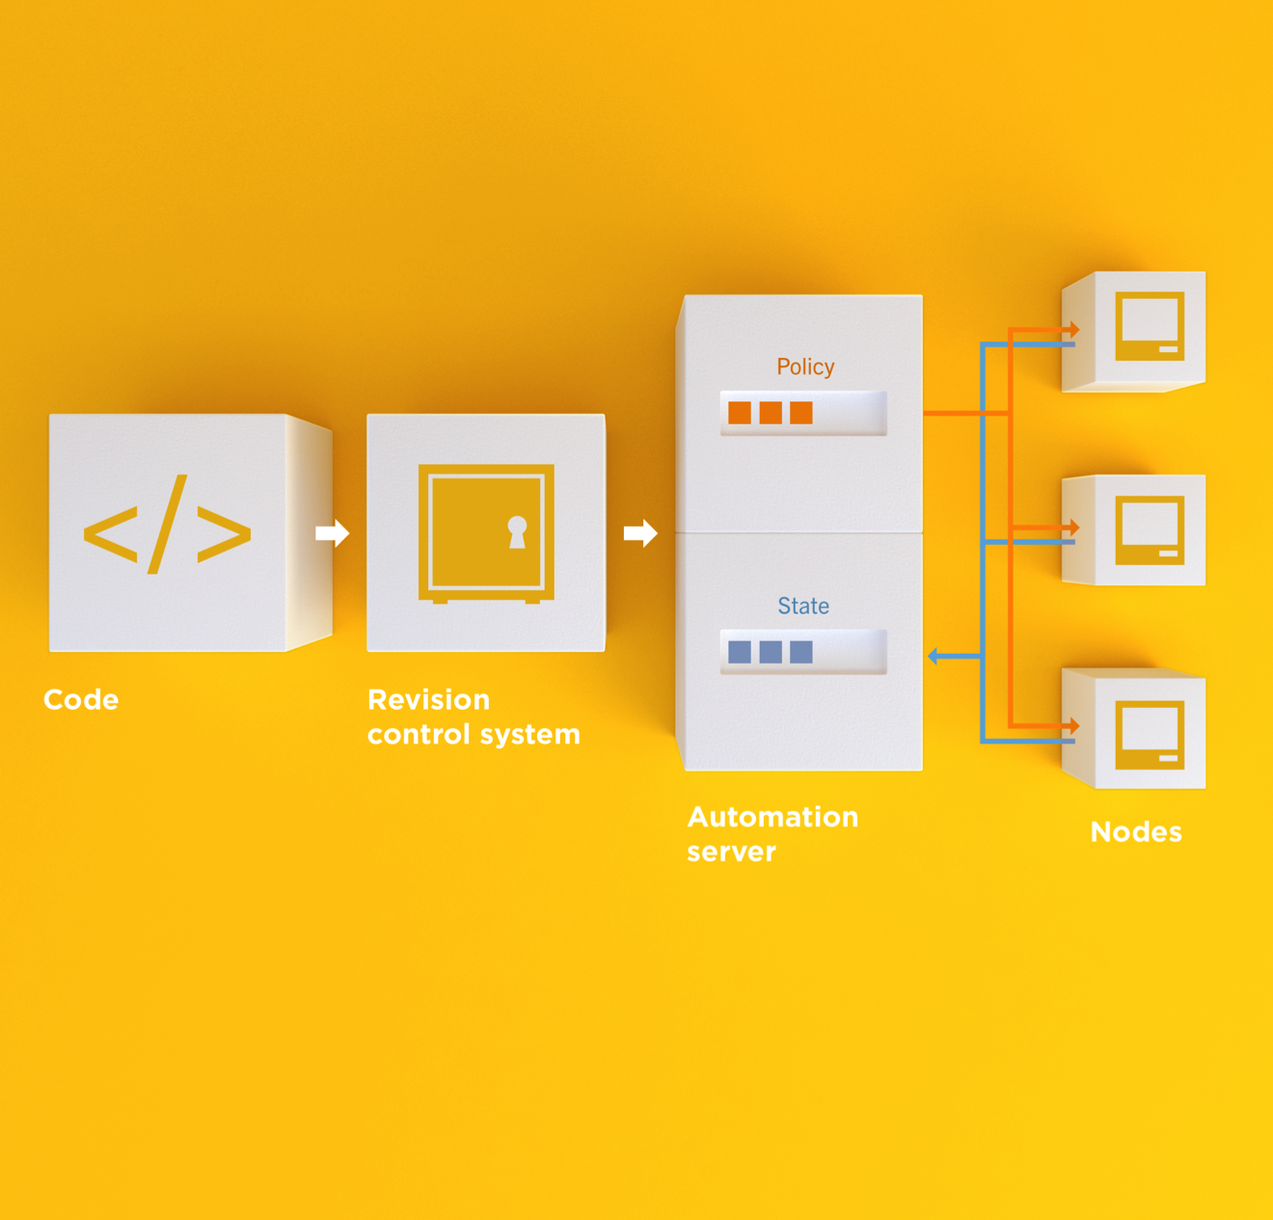
Infrastructure as Code
Programmatically provision and configure components
Treat like any other code base
Reconstruct business from code repository, data backup, and compute resources
Notes:
Stop for a minute and think about what we're saying here. Think about how freeing this can be. The next configuration change you need to make in production starts with a commit to your version control system. You can re-provision your infrastructure with another service provider; move from the data center to the clould and back again.How will this impact the way you run operations in your organization?What questions do you have?

Slide 25
Policy-based
You capture the policy for your infrastructure in code
Chef ensures each node in your infrastructure complies with the policy

Slide 26
Policy-based
Chef provides a domain-specific language (DSL) that allows you to specify policy for your infrastructure
Policy describes the desired state
Policies can be statically or dynamically defined
Notes:
Reduce complexity through abstraction
Store the code in version control (of course)
Static – the name of a package that should be installed
Dynamic – the hostname of the database server in the production environment

Slide 27
Building your policy
Resources and Recipes
Notes:
Policy is defined as a collection of resources in recipes. There are lots of abstractions on top of this but resources are the basic building blocks.

Slide 28
Resources
Piece of the system and its desired state

Slide 29
Resources - Package
Package that should be installed
package "mysql-server" do
action :install
end

Slide 30
Resources - Service
Service that should be running and restarted on reboot
service "iptables" do
action [ :start, :enable ]
end

Slide 31
Resources - Service
File that should be generated
file "/etc/motd" do
content "Property of Chef Software"
end

Slide 32
Resources - Cron
Cron job that should be configured
cron "restart webserver" do
hour '2'
minute '0'
command 'service httpd restart'
end

Slide 33
Resources - User
User that should be managed
user "nginx" do
comment "Nginx user <nginx@example.com>"
uid 500
gid 500
supports :manage_home => true
end

Slide 34
Resources - DSC
DSC resource that should be run
dsc_script 'emacs' do
code <<-EOH
Environment 'texteditor'
{
Name = 'EDITOR'
Value = 'c:\\emacs\\bin\\emacs.exe'
}
EOH
end

Slide 35
Resources – Registry Key
Registry key that should be created
registry_key "HKEY_LOCAL_MACHINE\\SOFTWARE\\Microsoft\\Windows\\CurrentVersion\\Policies\\System" do
values [{
:name => "EnableLUA",
:type => :dword,
:data => 0
}]
action :create
end

Slide 36
Resources
Piece of the system and its desired state
http://docs.chef.io/chef/resources.html

Slide 37
Login to your lab machine
username chef password chef.io
ssh chef@54.164.75.30
The authenticity of host '54.165.227.226 (54.165.227.226)' can't be established.
RSA key fingerprint is c1:ec:ab:66:fb:22:4a:8f:c2:c5:9b:26:77:f3:dd:b3.
Are you sure you want to continue connecting (yes/no)? yes
Warning: Permanently added '54.165.227.226' (RSA) to the list of known hosts.
chef@54.165.227.226's password:

Slide 38
Welcome to your workstation
ChefDK version 0.10.0 is installed
chef --version
Chef user has passwordless sudo access
sudo cat /etc/shadow

Slide 39
chef-apply
chef-apply is an executable program that allows you to work with resources
Is included as part of the ChefDK
A great way to explore resources
NOT how you’ll eventually use Chef in production

Slide 40
Install cowsay
sudo chef-apply -e "package 'cowsay'"
Recipe: (chef-apply cookbook)::(chef-apply recipe)
* yum_package[cowsay] action install
- install version 3.03-8.2.amzn1 of package cowsay

Slide 41
Say hello
cowsay "hello, #cheffriends"
________________
< hello, #cheffriends>
----------------
\ ^__^
\ (oo)\_______
(__)\ )\/\
||----w |
|| ||

Slide 42
Resources
Describe the desired state
Do not need to tell Chef how to get there
What happens if you re-run the chef-apply command?

Slide 43
Install cowsay again with chef-apply
sudo chef-apply -e "package 'cowsay'"
Recipe: (chef-apply cookbook)::(chef-apply recipe)
* yum_package[cowsay] action install (up to date)

Slide 44
Test and Repair
Resources follow a test and repair model
package "vim"

Slide 45
Test and Repair
Resources follow a test and repair model
package "vim"
Is vim installed?
Test

Slide 46
Test and Repair
Resources follow a test and repair model
package "vim"
Is vim installed?
Test
Yes

Slide 47
Test and Repair
Resources follow a test and repair model
package "vim"
Is vim installed?
Test
Yes
Done

Slide 48
Test and Repair
Resources follow a test and repair model
package "vim"
Is vim installed?
Test
Yes
No
Done

Slide 49
Test and Repair
Resources follow a test and repair model
package "vim"
Is vim installed?
Test
Yes
No
Done
Install it

Slide 50
Test and Repair
Resources follow a test and repair model
package "vim"
Is vim installed?
Test
Yes
No
Repair
Done
Install it

Slide 51
Resources – Test and Repair
Resources follow a test and repair model
Resource currently in the desired state? (test)
Yes – Do nothing
No – Bring the resource into the desired state (repair)

Slide 52
Resources
package
template
service
directory
user
group
dsc_script
registry_key
powershell_script
cron
mount
route
…and more!
Notes:
Of course, there are lots of different types of resources that come with Chef
View them all on docs.chef.io/resources.html

Slide 53
Recipes
Policy is defined as a collection of resources in recipes. There are lots of abstractions on top of this but resources are the basic building blocks.

Slide 54
Recipes
Collection of resources

Slide 55
Lab 2 – Serve our homepage
Problem: We need a web server configured to serve up our home page
Success Criteria: We see our home page in a web browser

Slide 56
What is our desired state?
We see our home page in a web browser

Slide 57
What is required to meet this state?
What resources will we need?
Notes:
Web server installed (package)
Web server running (service)
Home page with HTML content (file)

Slide 58
Recipe
Collection of resources
Recipes can:
Install and configure software components
Manage files
Deploy applications
Execute other recipes
And more…

Slide 59
Create learnchef/lab2 directory
mkdir -p ~/learnchef/lab2

Slide 60
Move to the learnchef/lab2 directory
cd ~/learnchef/lab2

Slide 61
Is there a web server?
curl http://localhost
curl: (7) couldn't connect to host

Slide 62
Write a recipe for apache
~/learnchef/lab2/apache.rb
package 'apache2'

Slide 63
Apply the apache recipe
sudo chef-apply apache.rb
Recipe: (chef-apply cookbook)::(chef-apply recipe)
* apt_package[apache2] action install
- install version 2.4.7-1ubuntu4.5 of package apache2

Slide 64
chef-apply a recipe
Now we are using chef-apply on a recipe, or a collection of resources
Success?

Slide 65
Is it working?
curl http://localhost
<!DOCTYPE html PUBLIC "-//W3C//DTD XHTML 1.0 Transitional//EN" "http://www.w3.org/TR/xhtml1/DTD/xhtml1-transitional.dtd">
<html xmlns="http://www.w3.org/1999/xhtml">
<!--
Modified from the Debian original for Ubuntu
Last updated: 2014-03-19
See: https://launchpad.net/bugs/1288690
-->
<head>
<meta http-equiv="Content-Type" content="text/html; charset=UTF-8" />
<title>Apache2 Ubuntu Default Page: It works</title>

Slide 66
Write a recipe for apache
~/learnchef/lab2/apache.rb
package 'apache2'
service 'apache2' do
action :start
end

Slide 67
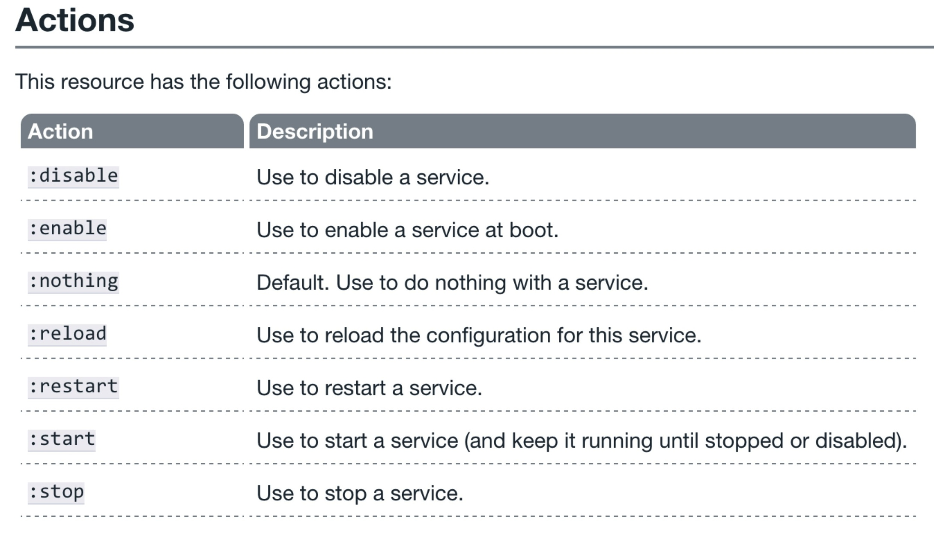
The service resource
http://docs.getchef.com/resource_service.html

Slide 68
Resources
Type (package, service, etc.)
Name (“httpd”, “vim”, etc.)
Actions
A description of the desired state of the resource
Defined as part of the resource
Will the action always be executed?

Slide 69
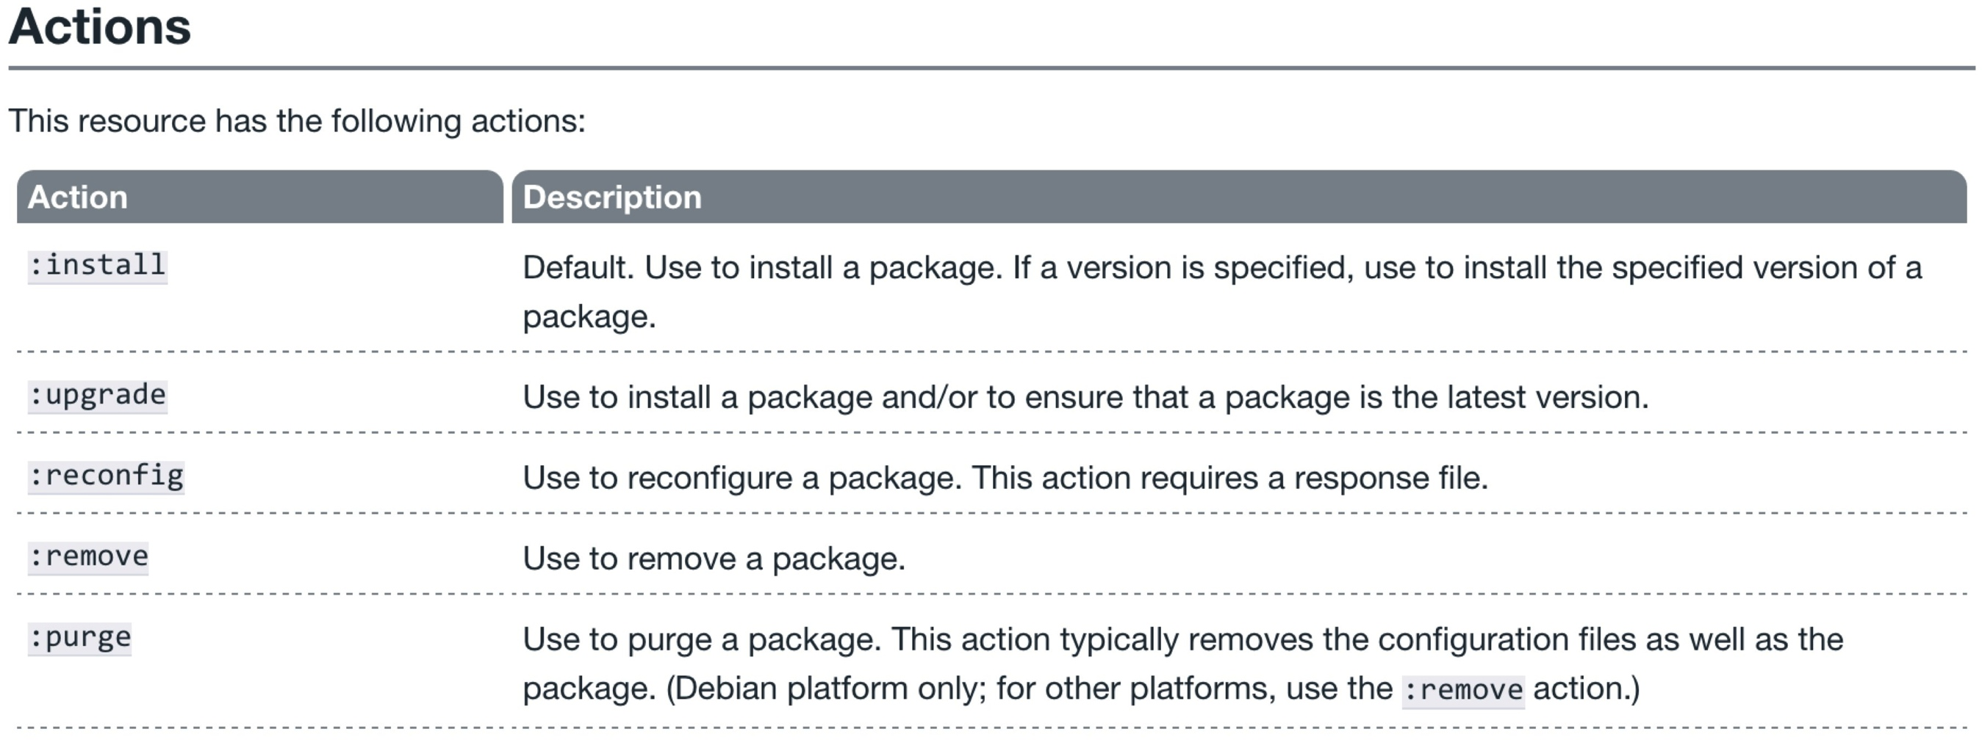
Why did the package resource work?
http://docs.getchef.com/resource_package.html

Slide 70
Why did the package resource work?
http://docs.getchef.com/resource_package.html

Slide 71
Apply the apache recipe
sudo chef-apply apache.rb
Recipe: (chef-apply cookbook)::(chef-apply recipe)
* apt_package[apache2] action install (up to date)
* service[apache2] action start (up to date)

Slide 72
Is it working?
curl http://localhost
<!DOCTYPE html PUBLIC "-//W3C//DTD XHTML 1.0 Transitional//EN" "http://www.w3.org/TR/xhtml1/DTD/xhtml1-transitional.dtd">
<html xmlns="http://www.w3.org/1999/xhtml">
<!--
Modified from the Debian original for Ubuntu
Last updated: 2014-03-19
See: https://launchpad.net/bugs/1288690
-->
<head>
<meta http-equiv="Content-Type" content="text/html; charset=UTF-8" />
<title>Apache2 Ubuntu Default Page: It works</title>

Slide 73
Not there yet
The web server is up and running
The default home page is being displayed, not our home page

Slide 74
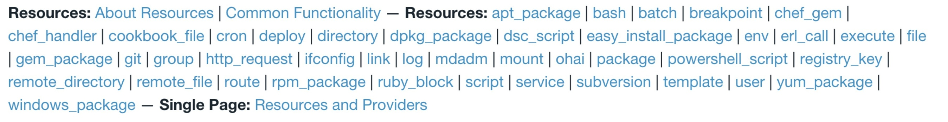
What resource should we use?
http://docs.getchef.com/

Slide 75
What resource should we use?
http://docs.getchef.com/

Slide 76
What resource should we use?
http://docs.getchef.com/

Slide 77
What resource should we use?
http://docs.getchef.com/

Slide 78
What resource should we use?
http://docs.getchef.com/

Slide 79
File Resource
Use the file resource to manage files that are present on a node, including setting or updating the contents of those files.

Slide 80
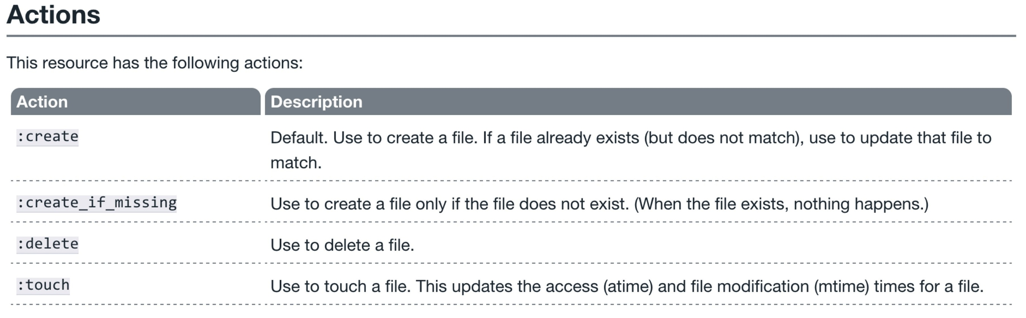
File Resource - Actions
http://docs.getchef.com/resource_file.html#actions

Slide 81

File Resource – content attribute
http://docs.getchef.com/resource_file.html#actions

Slide 82
Write a recipe for apache
~/learnchef/apache.rb
Package 'apache2'
service 'apache2' do
action :start
end
file '/var/www/html/index.html' do
content "<h1>hello world</h1>\n"
end

Slide 83
Re-apply the recipe
sudo chef-apply apache.rb
- </div>
- </div>
- <div class="validator">
- <p>
- <a href="http://validator.w3.org/check?uri=referer"><img src="http://www.w3.org/Icons/valid-xhtml10" alt="Valid XHTML 1.0 Transitional" height="31" width="88" /></a>
- </p>
- </div>
- </body>
-</html>
-
+<h1>hello world</h1>

Slide 84
Is it working?
curl http://localhost
<h1>hello world</h1>

Slide 85
Scenario testing
System administrator logs in to the server and changes the file manually.

Slide 86
Change the home page (use sudo)
/var/www/html/index.html
<h1>Hello, You!</h1>
Notes:
You probably need to use sudo here

Slide 87
Is it working?
curl http://localhost
<h1>Hello, You!</h1>

Slide 88
Re-apply the recipe
sudo chef-apply apache.rb
Recipe: (chef-apply cookbook)::(chef-apply recipe)
* apt_package[apache2] action install (up to date)
* service[apache2] action start (up to date)
* file[/var/www/html/index.html] action create
- update content in file /var/www/html/index.html from 681590 to cdf94d
--- /var/www/html/index.html 2015-09-23 10:19:30.541649829 +0000
+++ /var/www/html/.index.html20150923-12116-1kyd5rv 2015-09-23 10:19:36.076415999 +0000
@@ -1,2 +1,2 @@
-<h1>hello you</h1>
+<h1>hello world</h1>

Slide 89
Key Learning
Do not manually change files that are being managed by Chef
Changes always start in the code repository

Slide 90
Separating data from policy
Storing the home page content directly in the recipe feels wrong
We can manage that content separately using a different resource
cookbook_file
remote_file
template

Slide 91
Template resource
An ERB template that is used to generate files based on the variables and logic contained within the template.

Slide 92
Problem!
chef-apply is not capable of loading templates
Templates do not belong in the recipe file
It’s time to graduate to chef-client and a cookbook

Slide 93
Cookbooks
Recipes and supporting files

Slide 94
Cookbooks
A cookbook is like a “package” for Chef configuration and policy
Every cookbook will have a name & version
A cookbook can contain
Recipes
Files & Templates
Data attributes
Libraries
And more…

Slide 95
Cookbooks
Typically map 1:1 to a piece of software or functionality.
For example
mysql
users
security
apache
ntp

Slide 96
Infrastructure as Code
Package code into distributable units
Version the code and the packages
Separate data and policy
The web server should have a home page
The home page should have specific content

Slide 97
Lab 3 – Manage the homepage content separately
Problem: Storing the home page content in the recipe is unmanageable
Success Criteria: The home page is stored in it’s own file

Slide 98
chef
chef is an executable command line tool for
generating cookbooks, recipes, and other things that make up your Chef code
ensuring RubyGems are downloaded properly for your development environment
verifying that all the components are installed and configured correctly
Included with ChefDK
Notes:
https://docs.getchef.com/ctl_chef.html

Slide 99
Lab 3 – Manage the homepage content separately
Problem: Storing the home page content in the recipe is unmanageable
Success Criteria: The home page is stored in it’s own file

Slide 100
Lab 3 – Manage the homepage content separately
Create a chef-repo
Create an apache cookbook

Slide 101
What can chef generate?
chef generate --help
Usage: chef generate GENERATOR [options]
Available generators:
app Generate an application repo
cookbook Generate a single cookbook
recipe Generate a new recipe
attribute Generate an attributes file
template Generate a file template
file Generate a cookbook file
lwrp Generate a lightweight resource/provider
repo Generate a Chef policy repository

Slide 102
How do we generate a repo?
chef generate repo --help
Usage: chef generate repo NAME [options]
-C, --copyright COPYRIGHT Name of the copyright holder - defaults to 'The Authors'
-m, --email EMAIL Email address of the author - defaults to 'you@example.com'
-I, --license LICENSE all_rights, apache2, mit, gplv2, gplv3 - defaults to all_rights
-p, --policy-only Create a repository for policy only, not cookbooks
-g GENERATOR_COOKBOOK_PATH, Use GENERATOR_COOKBOOK_PATH for the code_generator cookbook
--generator-cookbook

Slide 103
Lab 3 – Manage the homepage content separately
Create a chef-repo
Create an apache cookbook

Slide 104
Go home!
cd ~

Slide 105
Create a chef-repo
chef generate repo chef-repo -p
Compiling Cookbooks...
Recipe: code_generator::repo
* directory[/home/chef/chef-repo] action create
- create new directory /home/chef/chef-repo
- restore selinux security context
* template[/home/chef/chef-repo/LICENSE] action create
- create new file /home/chef/chef-repo/LICENSE
- update content in file /home/chef/chef-repo/LICENSE from none to dbc1af
(diff output suppressed by config)
- restore selinux security context
* cookbook_file[/home/chef/chef-repo/README.md] action create
- create new file /home/chef/chef-repo/README.md
- update content in file /home/chef/chef-repo/README.md from none to 767ead
(diff output suppressed by config)
- restore selinux security context
* cookbook_file[/home/chef/chef-repo/Rakefile] action create
Notes:
-p creates a policy only repository
Policy only repo includes the following in the .gitignore
cookbooks/**
!cookbooks/README.md
So the cookbooks directory will be ignored.

Slide 106
Commit this chef-repo to git
cd chef-repo

Slide 107
Initialize repository
git init
Initialized empty Git repository in /home/chef/chef-repo/.git/

Slide 108
Commit this chef-repo to git
git add .

Slide 109
Commit this chef-repo to git
git commit -m "Initial chef-repo"
[master (root-commit) 6774a70] Initial chef repo
11 files changed, 388 insertions(+), 0 deletions(-)
create mode 100644 .gitignore
create mode 100644 LICENSE
create mode 100644 README.md
create mode 100644 Rakefile
create mode 100644 certificates/README.md
create mode 100644 chefignore
create mode 100644 config/rake.rb
create mode 100644 cookbooks/README.md
create mode 100644 data_bags/README.md
create mode 100644 environments/README.md
create mode 100644 roles/README.md

Slide 110
Lab 3 – Manage the homepage content separately
Create a chef-repo
Create an apache cookbook

Slide 111
Create an apache cookbook
chef generate cookbook --help
Usage: chef generate cookbook NAME [options]
-C, --copyright COPYRIGHT Name of the copyright holder - defaults to 'The Authors'
-m, --email EMAIL Email address of the author - defaults to 'you@example.com'
-I, --license LICENSE all_rights, apache2, mit, gplv2, gplv3 - defaults to all_rights
-g GENERATOR_COOKBOOK_PATH, Use GENERATOR_COOKBOOK_PATH for the code_generator cookbook
--generator-cookbook

Slide 112
Create an apache cookbook
cd cookbooks

Slide 113
Create an apache cookbook
chef generate cookbook apache
Compiling Cookbooks...
Recipe: code_generator::cookbook
* directory[/home/chef/chef-repo/cookbooks/apache] action create
- create new directory /home/chef/chef-repo/cookbooks/apache
- restore selinux security context
* template[/home/chef/chef-repo/cookbooks/apache/metadata.rb] action create_if_missing
- create new file /home/chef/chef-repo/cookbooks/apache/metadata.rb
- update content in file /home/chef/chef-repo/cookbooks/apache/metadata.rb from none to 94785f
(diff output suppressed by config)
- restore selinux security context
* template[/home/chef/chef-repo/cookbooks/apache/README.md] action create_if_missing
- create new file /home/chef/chef-repo/cookbooks/apache/README.md
- update content in file /home/chef/chef-repo/cookbooks/apache/README.md from none to 5c3d3a
(diff output suppressed by config)
- restore selinux security context
* cookbook_file[/home/chef/chef-repo/cookbooks/apache/chefignore] action create
- create new file /home/chef/chef-repo/cookbooks/apache/chefignore
- update content in file /home/chef/chef-repo/cookbooks/apache/chefignore from none to 9727b1
(diff output suppressed by config)
- restore selinux security context
* cookbook_file[/home/chef/chef-repo/cookbooks/apache/Berksfile] action create_if_missing

Slide 114
Create new git repo for this cookbook
cd apache

Slide 115
Create new git repo for this cookbook
git init
Initialized empty Git repository in /home/chef/chef-repo/cookbooks/apache/.git/

Slide 116
Commit the initial cookbook
git add .

Slide 117
Commit the initial cookbook
git commit -m "initial apache recipe, does nothing"
[master (root-commit) af2b629] initial apache recipe, does nothing
6 files changed, 144 insertions(+), 0 deletions(-)
create mode 100644 .kitchen.yml
create mode 100644 Berksfile
create mode 100644 README.md
create mode 100644 chefignore
create mode 100644 metadata.rb
create mode 100644 recipes/default.rb

Slide 118
Write the default recipe
chef-repo/cookbooks/apache/recipes/default.rb
#
# Cookbook Name:: apache
# Recipe:: default
#
# Copyright (c) 2014 The Authors, All Rights Reserved.
package 'apache2'
service 'apache2' do
action :start
end
file '/var/www/html/index.html' do
content "<h1>hello world</h1>\n"
end
Notes:
Can also copy from lab2
cp ~/learnchef/lab2/apache.rb ~/chef-repo/cookbooks/apache/default.rb

Slide 119
Wait a second!
We wanted to move the contents of the home page to another file
Let’s replace the file resource with a template resource

Slide 120
Replace the file resource
chef-repo/cookbooks/apache/recipes/default.rb
...
template "/var/www/html/index.html" do
source "index.html.erb"
end
Notes:
Can also copy from lab2
cp ~/learnchef/lab2/apache.rb ~/chef-repo/cookbooks/apache/default.rb

Slide 121
Template resource
An ERB template that is used to generate files based on the variables and logic contained within the template.

Slide 122
Create a new template file
Template files are ERB files
The chef command includes a template generator

Slide 123
Let’s create a template!
chef generate template --help
Usage: chef generate template [path/to/cookbook] NAME [options]
-C, --copyright COPYRIGHT Name of the copyright holder - defaults to 'The Authors'
-m, --email EMAIL Email address of the author - defaults to 'you@example.com'
-I, --license LICENSE all_rights, apache2, mit, gplv2, gplv3 - defaults to all_rights
-s, --source SOURCE_FILE Copy content from SOURCE_FILE
-g GENERATOR_COOKBOOK_PATH, Use GENERATOR_COOKBOOK_PATH for the code_generator cookbook
--generator-cookbook

Slide 124
Go to the chef-repo
cd ~/chef-repo

Slide 125
Let’s create a template!
chef generate template cookbooks/apache/ index.html -s /var/www/html/index.html
Compiling Cookbooks...
Recipe: code_generator::template
* directory[cookbooks/apache/templates/default] action create
- create new directory cookbooks/apache/templates/default
- restore selinux security context
* file[cookbooks/apache/templates/default/index.html.erb] action create
- create new file cookbooks/apache/templates/default/index.html.erb
- update content in file cookbooks/apache/templates/default/index.html.erb from none to cdf94d
(diff output suppressed by config)
- restore selinux security context
Notes:
chef generate template [path/to/cookbook] NAME [options]
-s source file, copy the contents from this file into the template

Slide 126
Check the template
cat cookbooks/apache/templates/default/index.html.erb
<h1>hello world</h1>

Slide 127
Lab 3 – Manage the homepage content separately
Create a chef-repo
Create an apache cookbook

Slide 128
Verify the changes
sudo chef-client -z -r "recipe[apache]"
[2015-09-23T10:24:16+00:00] WARN: No config file found or specified on command line, using command line options.
Starting Chef Client, version 12.4.1
resolving cookbooks for run list: ["apache"]
Synchronizing Cookbooks:
- apache
Compiling Cookbooks...
Converging 3 resources
Recipe: apache::default
* apt_package[apache2] action install (up to date)
* service[apache2] action start (up to date)
* template[/var/www/html/index.html] action create (up to date)
Running handlers:
Running handlers complete
Chef Client finished, 0/3 resources updated in 1.403112927 seconds

Slide 129
Verify the changes
curl http://localhost
<h1>hello world</h1>

Slide 130
Ensuring desired state
chef-client and run lists

Slide 131
chef-client
chef-client is an executable
performs all actions required to bring the node into the desired state
typically run on a regular basis
daemon
cron
Windows service
Included with ChefDK

Slide 132
chef-client modes
In conjunction with a Chef Server
Local mode (no Chef Server)

Slide 133
chef-client privileges
Usually run with elevated privileges
root
sudo
Administrator
Can run as a normal user

Slide 134
Desired State
Policies describe the desired state
Each node can follow a sub-set of policies
The policies for each node are stored in a run list

Slide 135


Run List
ntp cookbook
users cookbook
mysql cookbook

Slide 136
Run List
recipe[ntp::client]
recipe[users]
ntp cookbook
users cookbook
mysql cookbook

Slide 137
Run List
recipe[ntp::client]
recipe[users]
ntp cookbook
recipe[ntp::client]
recipe[users]
recipe[mysql::client]
users cookbook
mysql cookbook

Slide 138
Run List
recipe[ntp::client]
recipe[users]
ntp cookbook
recipe[ntp::client]
recipe[users]
recipe[mysql::client]
users cookbook
recipe[ntp::client]
recipe[users]
recipe[mysql::server]
mysql cookbook

Slide 139
Run List
recipe[ntp::client]
recipe[users]
ntp cookbook
recipe[ntp::client]
recipe[users]
recipe[mysql::client]
users cookbook
recipe[ntp::client]
recipe[users]
recipe[mysql::server]
mysql cookbook

Slide 140
Lab 4 – Verify the cookbook
Problem: We need to test our new apache cookbook
Success Criteria: The default recipe applies cleanly and our home page is visible

Slide 141
Run chef-client with a run list
sudo chef-client -z -r "recipe[apache]"
[2015-09-23T10:24:44+00:00] WARN: No config file found or specified on command line, using command line options.
Starting Chef Client, version 12.4.1
resolving cookbooks for run list: ["apache"]
Synchronizing Cookbooks:
- apache
Compiling Cookbooks...
Converging 3 resources
Recipe: apache::default
* apt_package[apache2] action install (up to date)
* service[apache2] action start (up to date)
* template[/var/www/html/index.html] action create (up to date)
Running handlers:
Running handlers complete
Chef Client finished, 0/3 resources updated in 1.423703943 seconds

Slide 142
Verify the home page
curl http://localhost
<h1>hello world</h1>

Slide 143
Infrastructure State
The node object

Slide 144

Node Object
A node is a physical, virtual, or cloud machine that is managed by the chef-client
Node object is a data structure representing the state of a node
https://docs.getchef.com/chef_overview_nodes.html

Slide 145
Node state
chef-client saves the current state of the node
Local mode – in the nodes directory
Normal mode – on the Chef server

Slide 146
New directory: nodes
ls ~/chef-repo/nodes
ip-172-31-32-114.ec2.internal.json
Notes:
~/chef-repo/nodes

Slide 147
Explore the node’s .json file
less nodes/*.json
{
"name": "ip-172-31-32-114.ec2.internal",
"normal": {
"tags": [
]
},
"automatic": {
"languages": {
"ruby": {
"platform": "x86_64-linux",
"version": "2.1.2",
"release_date": "2014-05-08",
"target": "x86_64-unknown-linux-gnu",
"target_cpu": "x86_64",
"target_vendor": "unknown",
"target_os": "linux",
"host": "x86_64-unknown-linux-gnu",
"host_cpu": "x86_64",
"host_os": "linux-gnu",
…
Notes:
wc ~/chef-repo/nodes/ip-172-31-41-194.ec2.internal.json

Slide 148
ohai
A system profiler that is used to detect the state of nodes
Platform
Network
Memory
And much more
Included with ChefDK

Slide 149
Run ohai
ohai | less
{
"languages": {
"ruby": {
"platform": "x86_64-linux",
"version": "2.1.2",
"release_date": "2014-05-08",
"target": "x86_64-unknown-linux-gnu",
"target_cpu": "x86_64",
"target_vendor": "unknown",
"target_os": "linux",
"host": "x86_64-unknown-linux-gnu",
"host_cpu": "x86_64",
"host_os": "linux-gnu",
"host_vendor": "unknown",
"bin_dir": "/opt/chefdk/embedded/bin",
"ruby_bin": "/opt/chefdk/embedded/bin/ruby",
"gems_dir": "/opt/chefdk/embedded/lib/ruby/gems/2.1.0",
"gem_bin": "/opt/chefdk/embedded/bin/gem"
},
…

Slide 150
Use ohai to find the platform
ohai platform
[
"ubuntu"
]

Slide 151
Find the platform in the node object
grep '"platform"' nodes/*.json
"platform": "x86_64-linux",
"platform": "ubuntu",

Slide 152
Lab 5 – Read node attributes in our policy
Problem: We want to see some node details on our home page.
Success Criteria: Our home page includes additional information about the node

Slide 153
Display node attributes
cookbooks/apache/templates/default/index.html.erb
<h1>hello world</h1>
<p>
This is a <%= node['platform'] %> <%= node['platform_version'] %> server.
with <%= node['memory']['total'] %> RAM.
</p>

Slide 154
Display node attributes
cookbooks/apache/templates/default/index.html.erb
<h1>hello world</h1>
<p>
This is a <%= node["platform"] %> <%= node["platform_version"] %> server.
with <%= node["memory"]["total"] %> RAM.
</p>

Slide 155
Display node attributes
cookbooks/apache/templates/default/index.html.erb
<h1>hello world</h1>
<p>
This is a <%= node["platform"] %> <%= node["platform_version"] %> server.
with <%= node["memory"]["total"] %> RAM.
</p>

Slide 156
Display node attributes
cookbooks/apache/templates/default/index.html.erb
<h1>hello world</h1>
<p>
This is a <%= node["platform"] %> <%= node["platform_version"] %> server.
with <%= node["memory"]["total"] %> RAM.
</p>

Slide 157
Display node attributes
cookbooks/apache/templates/default/index.html.erb
<h1>hello world</h1>
<p>
This is a <%= node["platform"] %> <%= node["platform_version"] %> server.
with <%= node["memory"]["total"] %> RAM.
</p>

Slide 158
Verify the change
sudo chef-client -z -r "recipe[apache]"
* service[apache2] action start (up to date)
* template[/var/www/html/index.html] action create
- update content in file /var/www/html/index.html from cdf94d to 51b17b
--- /var/www/html/index.html 2015-09-23 10:19:36.076415999 +0000
+++ /tmp/chef-rendered-template20150923-12966-1muvnml 2015-09-23 10:26:04.779566767 +0000
@@ -1,2 +1,8 @@
<h1>hello world</h1>
+
+<p>
+ This is a ubuntu 14.04 server.
+ with 2048484kB RAM.
+</p>
+
Running handlers:
Running handlers complete
Chef Client finished, 1/3 resources updated in 1.390230459 seconds

Slide 159
Verify the change
curl http://localhost
<h1>hello world</h1>
<p>
This is a ubuntu 14.04 server.
with 2048484kB RAM.
</p>
Notes:
Might want / need to clarify node object vs. ohai
node object’s state is updated by chef-client
grep uptime nodes/*.json; ohai uptime; sleep 60; grep uptime nodes/*.json; ohai uptime
"uptime_seconds": 47716,
"uptime": "13 hours 15 minutes 16 seconds",
[
"13 hours 17 minutes 54 seconds"
]
"uptime_seconds": 47716,
"uptime": "13 hours 15 minutes 16 seconds",
[
"13 hours 18 minutes 55 seconds"
]

Slide 160
Custom node attributes
Ohai provides many attributes for the node object
You may want to include your own custom attributes

Slide 161
Lab 6 - Create a custom node attribute
Problem: We need a customized greeting on our home page.
Success Criteria: Our home page includes a custom greeting.

Slide 162
Lab 6 - Create a custom node attribute
Create the attribute
Display the attribute on the home page

Slide 163
chef can generate attributes
chef generate attribute --help
Usage: chef generate attribute [path/to/cookbook] NAME [options]
-C, --copyright COPYRIGHT Name of the copyright holder - defaults to 'The Authors'
-m, --email EMAIL Email address of the author - defaults to 'you@example.com'
-I, --license LICENSE all_rights, apache2, mit, gplv2, gplv3 - defaults to all_rights
-g GENERATOR_COOKBOOK_PATH, Use GENERATOR_COOKBOOK_PATH for the code_generator cookbook
--generator-cookbook

Slide 164
Generate attribute
chef generate attribute cookbooks/apache/ default
Compiling Cookbooks...
Recipe: code_generator::attribute
* directory[cookbooks/apache/attributes] action create
- create new directory cookbooks/apache/attributes
* template[cookbooks/apache/attributes/default.rb] action create
- create new file cookbooks/apache/attributes/default.rb
- update content in file cookbooks/apache/attributes/default.rb from none to e3b0c4
(diff output suppressed by config)

Slide 165
Create an attribute
cookbooks/apache/attributes/default.rb
default['apache']['greeting'] = 'DC'
Notes:
Good practice to name space your attributes within the cookbook

Slide 166
Update the home page
cookbooks/apache/templates/default/index.html.erb
<h1>hello <%= node['apache']['greeting'] %></h1>
<p>
This is a <%= node['platform'] %> <%= node['platform_version'] %> server.
with <%= node['memory']['total'] %> RAM.
</p>

Slide 167
Let’s look at the node
knife node list --local
WARNING: No knife configuration file found
ip-172-31-47-246.ec2.internal

Slide 168
Let’s look at the node
knife node show ip-172-31-28-107.ec2.internal --local
WARNING: No knife configuration file found
Node Name: ip-172-31-47-246.ec2.internal
Environment: _default
FQDN: ip-172-31-47-246.ec2.internal
IP: 54.173.239.129
Run List: recipe[apache]
Roles:
Recipes: apache::default
Platform: ubuntu 14.04
Tags:

Slide 169
Let’s look at the node
knife node show ip-172-31-47-246.ec2.internal --local -a apache
WARNING: No knife configuration file found
ip-172-31-47-246.ec2.internal:
apache:

Slide 170
Apply the change
sudo chef-client -z
* template[/var/www/html/index.html] action create
- update content in file /var/www/html/index.html from 51b17b to a74dd1
--- /var/www/html/index.html 2015-09-23 10:26:04.779566767 +0000
+++ /tmp/chef-rendered-template20150923-13358-f6f2s3 2015-09-23 10:29:40.691566767 +0000
@@ -1,4 +1,4 @@
-<h1>hello world</h1>
+<h1>hello DC</h1>
<p>
This is a ubuntu 14.04 server.
Running handlers:
Running handlers complete
Chef Client finished, 1/3 resources updated in 1.420250472 seconds

Slide 171
Verify the change
curl http://localhost
<h1>hello DC</h1>
<p>
This is a ubuntu 14.04 server.
with 2048484kB RAM.
</p>
Notes:
Might want / need to clarify node object vs. ohai
node object’s state is updated by chef-client
grep uptime nodes/*.json; ohai uptime; sleep 60; grep uptime nodes/*.json; ohai uptime
"uptime_seconds": 47716,
"uptime": "13 hours 15 minutes 16 seconds",
[
"13 hours 17 minutes 54 seconds"
]
"uptime_seconds": 47716,
"uptime": "13 hours 15 minutes 16 seconds",
[
"13 hours 18 minutes 55 seconds"
]

Slide 172
Let’s look at the node
knife node show ip-172-31-47-246.ec2.internal --local -a apache
WARNING: No knife configuration file found
ip-172-31-47-246.ec2.internal:
apache:
greeting: DC

Slide 173
Faster Feedback
Automate your testing

Slide 174
Our process
Write policy
Apply policy
Verify policy
Not bad for the simple case, will quickly get untenable

Slide 175
Faster Feedback
Speed-up the feedback loops with automated testing.
Have confidence in your changes before you run them in production

Slide 176
Chef Testing
Did chef-client complete successfully?
Did the recipe put the node in the desired state?
Are the resources properly defined?
Does the code following our style guide?

Slide 177
Chef client success status
Requirements to verify chef-client success:
A place to store the cookbook artifact

Slide 178
Chef client success status
Requirements to verify chef-client success:
A place to store the cookbook artifact
A chef-client with access to the cookbook

Slide 179
Chef client success status
Requirements to verify chef-client success:
A place to store the cookbook artifact
A chef-client with access to the cookbook
A target server running the same OS as production

Slide 180

Test Kitchen
Test harness to execute code on one or more platforms
Driver plugins to allow your code to run on various cloud and virtualization providers
Includes support for many testing frameworks
Included with ChefDK
Notes:
To do this, we’re going to use Test Kitchen! Test Kitchen is a delightful tool which allows us to spin up a VM or container, configure it with our Chef code, then verify that the VM or container is in the state we expect it to be after our Chef run is complete.

Slide 181
Test Matrix
Two operating systems
ubuntu-12.04
centos-6.4
Notes:
One of the nicest things about Test Kitchen is that we can test that our Chef code on multiple operating systems. I can test whether the same cookbook will work on both Ubuntu-12.04 and Centos 6.4

Slide 182
Test Matrix
Two operating systems
One recipe
 | default
ubuntu-12.04 | apache::default
centos-6.4 | apache::default
Notes:
I can then define which recipes in that cookbook I want to test and test that recipe on both platforms.

Slide 183
Test Matrix
Two operating systems
Two recipes
 | default | ssl
ubuntu-12.04 | apache::default | apache::ssl
centos-6.4 | apache::default | apache::ssl
Notes:
And if I have multiple recipes within the same cookbook, I can test all of them on both platforms.

Slide 184
Test Matrix
Three operating systems
Two recipes
 | default | ssl
ubuntu-12.04 | apache::default | apache::ssl
centos-6.4 | apache::default | apache::ssl
ubuntu-14.04 | apache::default | apache::ssl
Notes:
I can even add another operating system and run those same test suites on that operating system. Isn’t this delightful?

Slide 185
Configuring the Kitchen
cookbooks/apache/.kitchen.yml
---
driver:
name: vagrant
provisioner:
name: chef_zero
platforms:
- name: ubuntu-12.04
- name: centos-6.4
suites:
- name: default
run_list:
- recipe[apache::default]
attributes:
Notes:
So we configure what operating systems and what recipes we want to test in our .kitchen.yml file within the cookbooks. So go ahead and open up cookbooks/apache/.kitchen.yml and take a look at it.

Slide 186
.kitchen.yml
driver - virtualization or cloud provider
---
driver:
name: vagrant
provisioner:
name: chef_zero
platforms:
- name: ubuntu-12.04
- name: centos-6.4
suites:
- name: default
run_list:
- recipe[apache::default]
attributes:
Notes:
Let’s go through this file step by step. The first thing we declare is what driver we want to use. This defines where Test Kitchen will attempt to spin up an instance to test the recipe. This can be vagrant, it can be a cloud provider – I tend to use Digital Ocean when running test kitchen on a cloud provider because it’s nice and fast, or it can be a container provisioning tool like Docker

Slide 187
.kitchen.yml
provisioner - application to configure the node
---
driver:
name: vagrant
provisioner:
name: chef_zero
platforms:
- name: ubuntu-12.04
- name: centos-6.4
suites:
- name: default
run_list:
- recipe[apache::default]
attributes:
Notes:
Next thing we declare is how we’re going to simulate a chef-client run on our test instance – since our test instance won’t be connected to a Chef server. We can use either chef_zero as we do here, or chef_solo. I like to use Chef Zero because it runs in memory and is nice and fast for testing.

Slide 188
.kitchen.yml
platforms - target operating systems
---
driver:
name: vagrant
provisioner:
name: chef_zero
platforms:
- name: ubuntu-12.04
- name: centos-6.4
suites:
- name: default
run_list:
- recipe[apache::default]
attributes:
Notes:
Next is platforms, these are the OS we want to test the Chef code on.

Slide 189
.kitchen.yml
suites - target configurations
---
driver:
name: vagrant
provisioner:
name: chef_zero
platforms:
- name: ubuntu-12.04
- name: centos-6.4
suites:
- name: default
run_list:
- recipe[apache::default]
attributes:
Notes:
Suites are ways to group recipes to test. The run list of a suite defines which recipes will be applied to our Test Kitchen instance. Attributes allows us to add in values that we would expect to find on the server, but can’t necessarily know until we actually spin it up. I could provide a mock IP address as an attribute, then execute tests and verify that my Chef code finds that IP address and uses it as I expect it to. It’s similar to a stub or mock.

Slide 190
.kitchen.yml
 | default
ubuntu-12.04 | apache::default
centos-6.4 | apache::default
---
driver:
name: vagrant
provisioner:
name: chef_zero
platforms:
- name: ubuntu-12.04
- name: centos-6.4
suites:
- name: default
run_list:
- recipe[apache::default]
Notes:
A test suite can run multiple recipes. So we can have a default suite suite which will run our default recipe…

Slide 191
.kitchen.yml
 | default | ssl
ubuntu-12.04 | apache::default | apache::ssl
centos-6.4 | apache::default | apache::ssl
---
driver:
name: vagrant
provisioner:
name: chef_zero
platforms:
- name: ubuntu-12.04
- name: centos-6.4
suites:
- name: default
run_list:
- recipe[apache::default]
- name: ssl
run_list:
- recipe[apache::ssl]
Notes:
And we could have another suite which would test a recipe called ssl, which would configure ssl for apache.

Slide 192
.kitchen.yml
 | default | ssl
ubuntu-12.04 | apache::default | apache::ssl
centos-6.4 | apache::default | apache::ssl
ubuntu-14.04 | apache::default | apache::ssl
---
driver:
name: vagrant
provisioner:
name: chef_zero
platforms:
- name: ubuntu-12.04
- name: centos-6.4
- name: ubuntu-14.04
suites:
- name: default
run_list:
- recipe[apache::default]
- name: ssl
run_list:
- recipe[apache::ssl]
Notes:
I can also easily add additional operating systems I want to verify my Chef code works on.

Slide 193

Docker
Portable, lightweight application runtime
Linux containers
Installed on the workstation
https://d3oypxn00j2a10.cloudfront.net/0.10.3/img/homepage/docker-whale-home-logo-@2x.png?cf34b4b2b839

Slide 194
Verify docker
sudo docker images
REPOSITORY TAG IMAGE ID CREATED VIRTUAL SIZE
centos 6 72703a0520b7 2 weeks ago 190.6 MB
centos 7 0f73ae75014f 2 weeks ago 172.3 MB
ubuntu 14.04 91e54dfb1179 4 weeks ago 188.3 MB
centos 5 9069226e092e 5 months ago 284.1 MB
Notes:
The images were installed using: sudo docker pull cetos

Slide 195
kitchen-docker gem
A driver that allows Test Kitchen to work with Docker
Installed on the workstation
ChefDK includes kitchen-vagrant

Slide 196
Verify kitchen-docker is installed
chef gem list kitchen
*** LOCAL GEMS ***
kitchen-docker (2.3.0)
kitchen-vagrant (0.18.0)
test-kitchen (1.4.2)

Slide 197
Lab 7 – Verify chef-client success
Problem: Testing our cookbook takes too long
Success Criteria: Our cookbook runs in test kitchen

Slide 198
Move to the apache cookbook directory
cd ~/chef-repo/cookbooks/apache

Slide 199
Update .kitchen.yml
.kitchen.yml
---
driver:
name: docker
use_sudo: false
provisioner:
name: chef_zero
platforms:
- name: ubuntu-14.04
suites:
- name: default
run_list:
- recipe[apache::default]
attributes:
Notes:
And update our .kitchen.yml file.
We’re going to update the driver – all the cool kids are using docker these days, so let’s use that as our driver.
We’re going to leave the provisioner as chef_zero, keep it nice and fast
Let’s only test this on ubuntu-14.04 for now, so go ahead and remove the centos line
And for now we’re only going to define the default suite and the only recipe we need in our run list is the default recipe
Then save and close the file…I’ll give you minute or so to make these changes.

Slide 200
List the Test Kitchens
kitchen list
Instance Driver Provisioner Verifier Transport Last Action
default-ubuntu-1404 Docker ChefZero Busser Ssh <Not Created>
Notes:
Back at the command line, run the command kitchen list. This shows us all the “kitchens” we have configured – in this case, it’s only one. Our kitchen will run the default suite on Ubuntu 1204 using Docker and Chef Zero. Were we to add another operating system or test suite, we’re also see that on this list.

Slide 201
Create the kitchen
kitchen create
-----> Starting Kitchen (v1.4.2)
-----> Creating <default-ubuntu-1404>...
Sending build context to Docker daemon 103.4 kB
Sending build context to Docker daemon
Step 0 : FROM ubuntu:14.04
---> 91e54dfb1179
Step 1 : RUN dpkg-divert --local --rename --add /sbin/initctl
---> Running in 896cb2b32162
Leaving 'local diversion of /sbin/initctl to /sbin/initctl.distrib'
---> 7998c2114ff3
Removing intermediate container 896cb2b32162
Step 2 : RUN ln -sf /bin/true /sbin/initctl
---> Running in cc133734bf7d
Notes:
So now that we have it defined it in our kitchen.yml, it’s time to actually create the docker instance. We do this by running the kitchen create command. Let’s go ahead and run that, and it will take a couple of minutes to run. While we’re waiting, here’s a demo from Nathen on what the mysql community cookbook uses for test kitchens.

Slide 202
Kitchen created
Workstation
Kitchen
Notes:
Now that our kitchen is up, here’s a visual representation of what we just did. We have our workstation, then within that workstation we’re running a docker container with our kitchen inside it. We’re going to run tests from our workstation on the kitchen.

Slide 203
Login to the kitchen
kitchen login
$$$$$$ Running legacy login for 'Docker' Driver
Last login: Wed Sep 23 09:48:21 2015 from 172.17.42.1
Notes:
One of the nice things about Test Kitchen is that we can login to the container where it is running. Run kitchen login

Slide 204
Kitchen login
Workstation
Kitchen
Notes:
To demonstrate this visually, we again have our workstation with a container running kitchen inside it.

Slide 205
Kitchen login
Workstation
Kitchen
[chef@ip-172-31-44-173 apache]$ kitchen login
Notes:
Then we run kitchen login from our workstation

Slide 206
Kitchen login
Workstation
Kitchen
ssh
[chef@ip-172-31-44-173 apache]$ kitchen login
Notes:
And this ssh’es into our kitchen container

Slide 207
Kitchen login
Workstation
Kitchen
[kitchen@5379d310dc59 ~]$
ssh
[chef@ip-172-31-44-173 apache]$ kitchen login
Notes:
And now we can run commands within that container.

Slide 208
Chef client success status
Requirements to verify chef-client success:
A target server running the same OS as production
A chef-client with access to the cookbook
Notes:
So in order to verify our chef-client runs successfully, remember that we need a target server running the same OS as production, and a chef-client with access to the cookbook

Slide 209
Lab – Apply our policy
Problem: We have not applied our policy to the test environment.
Success Criteria: The default apache recipe will be applied in the test environment
Notes:
So now let’s do some lab work and actually apply our Chef policy to this testing docker instance.

Slide 210
Leave the kitchen
exit
logout
Connection to localhost closed.
Notes:
So go ahead and exit your kitchen docker instance the usual way, with “exit”

Slide 211
Go to the right place
cd ~/chef-repo/cookbooks/apache
Notes:
And make sure you’re within your apache cookbook directory on your workstation

Slide 212
Apply our policy
kitchen converge
-----> Starting Kitchen (v1.4.2)
-----> Converging <default-centos-71>...
$$$$$$ Running legacy converge for 'Docker' Driver
Preparing files for transfer
Preparing dna.json
Resolving cookbook dependencies with Berkshelf 3.2.4...
Removing non-cookbook files before transfer
Preparing validation.pem
Preparing client.rb
-----> Installing Chef Omnibus (install only if missing)
Downloading https://www.chef.io/chef/install.sh to file /tmp/install.sh
Trying curl...
Download complete.
Downloading Chef for el...
downloading https://www.chef.io/chef/metadata?v=&prerelease=false&nightlies=false&p=el&pv=7&m=x86_64
Notes:
Our next step is to run the command kitchen converge. This installs Chef if it’s not already installed and…

Slide 213
Kitchen converge
Workstation
Kitchen
Install Chef
Upload cookbooks
Apply the run_list
Notes:
Uploads our cookbooks, then applies our run list. Remember we defined that run list in .kitchen.yml
Any Q and A while we’re waiting for that to run?

Slide 214
Questions to ask when testing
Did chef-client complete successfully?
Did the recipe put the node in the desired state?
Are the resources properly defined?
Does the code following our style guide?
Notes:
So when kitchen converge runs successfully, we can answer that first question. The chef-client run did indeed complete successfully! Congratulations, you’ve just completed your first test driven chef run without writing any tests or code at all! Now let’s move onto the next question…

Slide 215
Lab 8 – Verify the node
Problem: Successful converge does not necessarily mean the node is in the desired state.
Success Criteria: Verify our home page is being served.

Slide 216
Manually Inspect with kitchen login
kitchen login
$$$$$$ Running legacy login for 'Docker' Driver
Last login: Wed Sep 23 10:44:37 2015 from 172.17.42.1

Slide 217
Manually Inspect with kitchen login
curl http://localhost
<h1>hello DC</h1>
<p>
This is a ubuntu 14.04 server.
with 2048484kB RAM.
</p>

Slide 218

Serverspec
Write tests to verify your servers
Not dependent on Chef
Defines many resource types
package, service, user, etc.
Works well with Test Kitchen
http://serverspec.org/
Notes:
To do this, we’re going to use a tool called serverspec which allows us to write tests to verify the state of servers. It’s not limited to Chef – you can use it with Puppet, Ansible, etc. Serverspec defines many resource types- just like Chef- to describe what state we expect to find our infrastructure in. It works extremely well with Test Kitchen and is a delight to use.

Slide 219
Leave the Kitchen
exit
logout
Connection to localhost closed.
Notes:
So go ahead and exit out of your testing container.

Slide 220
Move to the proper directory
cd ~/chef-repo/cookbooks/apache
Notes:
And make sure you’re in your apache cookbook directory

Slide 221
Write a Serverspec test
test/integration/default/serverspec/default_spec.rb
require 'spec_helper'
describe 'apache::default' do
# Serverspec examples can be found at
# http://serverspec.org/resource_types.html
it 'does something' do
skip 'Replace this with meaningful tests'
end
end
Notes:
And now let’s write a ServerSpec test. Open up test/integration/default/serverspec/default_spec.rb with your editor of choice and this is what you’re going to see. When we generated this cookbook with Chef DK, it also generated a serverspec file for our default recipe. If you’re an rspec user, this syntax should look very familiar

Slide 222
Generic Expectation Form
describe "<subject>" do
it "<description>" do
expect(thing).to eq result
end
end
Notes:
Let’s take a closer we use a describe block to define the subject of our test, then we use it blocks to describe what we expect that subject to do or be doing. We use the same expect syntax that rspec uses to define what we expect the results of our code to be.

Slide 223
Awesome Expectations
test/integration/default/serverspec/default_spec.rb
require 'spec_helper’
describe "apache::default" do
it "is awesome" do
expect(true).to eq true
end
end
Notes:
So let’s add in an actual test. Within that describe block – the one that describes the default recipe of our Apache cookbook – let’s add in a test to ensure that our recipe is awesome. When our recipes are awesome we are awesome. Then save and close the file.

Slide 224
Run the serverspec test
kitchen verify
-----> Running serverspec test suite
/opt/chef/embedded/bin/ruby -I/tmp/busser/suites/serverspec -I/tmp/busser/gems/gems/rspec-support-3.1.2/lib:/tmp/busser/gems/gems/rspec-core-3.1.7/lib /opt/chef/embedded/bin/rspec --pattern /tmp/busser/suites/serverspec/\*\*/\*_spec.rb --color --format documentation --default-path /tmp/busser/suites/serverspec
apache::default
is awesome
Finished in 0.02823 seconds (files took 0.99875 seconds to load)
1 example, 0 failures
Finished verifying <default-centos-64> (0m5.03s).
Notes:
And run the command “kitchen verify” – this will run the actual tests on our test kitchen container. This will take a little bit to run…ultimately we should see a success – our recipe is indeed awesome.

Slide 225
How would you test our criteria?
What would you test to make sure apache is running?
Notes:
So now this brings us to the question – how do we test to make sure Apache is running? What would you test?

Slide 226
Verify package is installed
test/integration/default/serverspec/default_spec.rb
require 'spec_helper'
describe "apache" do
it "is awesome" do
expect(true).to eq true
end
it "is installed" do
expect(package("apache2")).to be_installed
end
end
Notes:
Let’s add in a test to check whether Apache is installed. Open up your serverspec file and add in the test:
And why we’re here, let’s add in some pending tests, Nathen’s going to plug in and demo this live. What other tests would you add to ensure Apache is running?

Slide 227
Verify the kitchen
kitchen verify
-----> Setting up Busser
Creating BUSSER_ROOT in /tmp/busser
Creating busser binstub
Plugin serverspec installed (version 0.2.6)
-----> Running postinstall for serverspec plugin
Finished setting up <default-centos-64> (0m32.59s).
-----> Verifying <default-centos-64>...
Suite path directory /tmp/busser/suites does not exist, skipping.
Uploading /tmp/busser/suites/serverspec/default_spec.rb (mode=0664)
-----> Running serverspec test suite
/opt/chef/embedded/bin/ruby -I/tmp/busser/suites/serverspec -S /opt/chef/embedded/bin/rspec /tmp/busser/suites/serverspec/default_spec.rb --color --format documentation
apache
is installed
Finished in 0.29547 seconds
1 example, 0 failures
Finished verifying <default-centos-64> (0m4.44s).
-----> Kitchen is finished. (1m25.74s)

Slide 228
Extend the Serverspec test
test/integration/default/serverspec/default_spec.rb
require 'spec_helper'
describe 'apache' do
it "is installed" do
expect(package 'httpd').to be_installed
end
it "is running" do
expect(service 'httpd').to be_running
end
it "is listening on port 80" do
expect(port 80).to be_listening
end
it "displays a custom home page" do
expect(command("curl localhost").stdout).to match /hello/
end
end

Slide 229
Verify the kitchen
kitchen verify
apache
is installed
is running
is listening on port 80
displays a custom home page
Finished in 0.3968 seconds
4 examples, 0 failures
Finished verifying <default-centos-64> (0m4.25s).

Slide 230
Change the test
test/integration/default/serverspec/default_spec.rb
require 'spec_helper'
describe 'apache' do
it "is installed" do
expect(package 'httpd').to be_installed
end
it "is running" do
expect(service 'httpd').to be_running
end
it "is listening on port 80" do
expect(port 81).to be_listening
end
it "displays a custom home page" do
expect(command("curl localhost").stdout).to match /hello/
end
end

Slide 231
Verify the kitchen
kitchen verify
apache
is installed
is running
is listening on port 80 (FAILED - 1)
displays a custom home page
Failures:
1) apache is listening on port 80
On host ``
Failure/Error: expect(port 81).to be_listening
netstat -tunl | grep -- :81\
expected Port "81" to be listening
# /tmp/busser/suites/serverspec/default_spec.rb:16:in `block (2 levels) in <top (required)>'
Finished in 0.38488 seconds
4 examples, 1 failure

Slide 232
Reset the Serverspec test
test/integration/default/serverspec/default_spec.rb
describe 'apache' do
it "is installed" do
expect(package 'httpd').to be_installed
end
it "is running" do
expect(service 'httpd').to be_running
end
it "is listening on port 80" do
expect(port 80).to be_listening
end
it "displays a custom home page" do
expect(command("curl localhost").stdout).to match /hello/
end
end

Slide 233
Kitchen Workflow
kitchen create
kitchen converge
kitchen verify
kitchen destroy
All at once with kitchen test

Slide 234
Chef Testing
Did chef-client complete successfully?
Did the recipe put the node in the desired state?
Are the resources properly defined?
Does the code following our style guide?

Slide 235
Even Faster Feedback
ChefSpec
Notes:
Now Test Kitchen is a wonderful tool for integration style testing…but there are times we want faster feedback than what we can get when we need to fully converge a VM or container.

Slide 236
This is too slow!
To test our code, we need to spin up a test kitchen, converge a node, execute some tests.
Our simple test case takes about 2 minutes to fully execute.
Notes:
Testing using test kitchen and server spec take about 2 minutes, sometimes more depending on which driver you’re using, to fully execute. That’s 2 or more minutes waiting for feedback when we could be moving on with our code.

Slide 237
Properly configured resources
We need a way to verify that the resources in our recipes are properly configured
We want to get faster feedback
Notes:
We need to verify that our recipes work, and we also need a way to get fast feedback

Slide 238
Lab – Verify the resources
Problem: We should be able to catch errors before we need to converge a node
Success Criteria: Catch a typo prior to converge
Notes:
So let’s demonstrate this with a lab. Our problem we need solve is to catch errors before we need to converge the node. The success criteria to check whether we’ve solved this problem is the ability to catch a typo prior to converge.

Slide 239
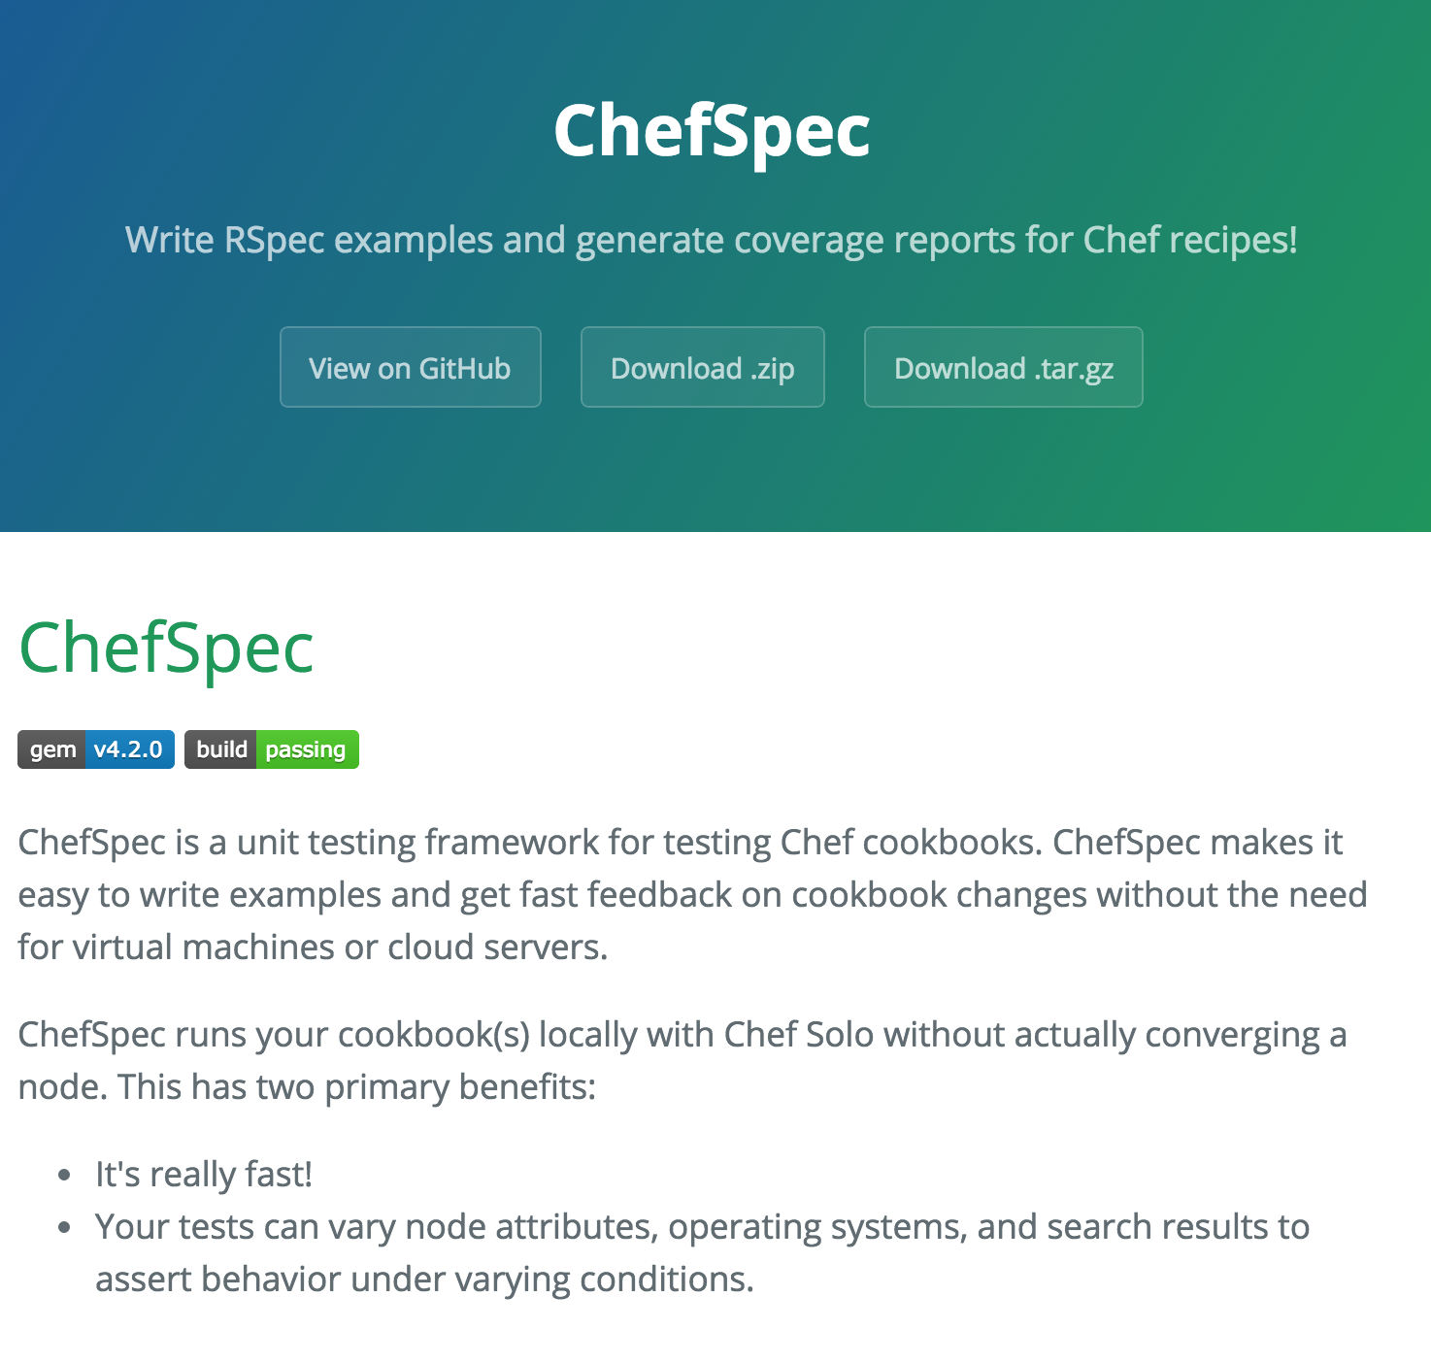
ChefSpec
Test before you converge
Get feedback on cookbook changes without the need for target servers
http://sethvargo.github.io/chefspec/
Notes:
And the tool we’re going to use is called ChefSpec. ChefSpec allows you to write unit tests in rspec and run them locally without ever needing to converge a test VM. Or container It’s a fantastic way to both write and execute unit tests, the iterate on our code quickly.

Slide 240
Change to the apache cookbook directory
cd ~/chef-repo/cookbooks/apache
Notes:
Let’s create a chefspec test. First, make sure you’re in your apache cookbook directory.

Slide 241
Write a ChefSpec test
spec/unit/recipes/default_spec.rb
require 'spec_helper'
describe 'apache::default' do
context 'When all attributes are default, on an unspecified platform' do
let(:chef_run) do
runner = ChefSpec::ServerRunner.new
runner.converge(described_recipe)
end
it 'converges successfully' do
expect { chef_run }.to_not raise_error
end
end
end
Notes:
When we generate a cookbook, Chef DK automatically generates a chef spec file for our default recipe. Go ahead and open that up and take a look. We’re using the describe block to declare the subject of the our tests – the default recipe of the Apache cookbook. Then we define a context – when all attributes are default, on an unspecified platform. Then we use some built in Chef Spec magic to do a chef client run and converge locally on our workstation. Then we test that it works successfully, saying that the chef_run should not raise an error.

Slide 242
Write a ChefSpec test
spec/unit/recipes/default_spec.rb
require 'spec_helper'
describe 'apache::default' do
context 'When all attributes are default, on an unspecified platform' do
let(:chef_run) do
runner = ChefSpec::ServerRunner.new
runner.converge(described_recipe)
end
it 'converges successfully' do
expect { chef_run }.to_not raise_error
end
it 'installs apache' do
expect(chef_run).to install_package 'apache2'
end
end
end
Notes:
Now let’s add in a test of our own. Let’s test that a Chef run will install the package ‘apache2’. Then save and exit the file.

Slide 243
Run the ChefSpec tests
chef exec rspec spec -fd -c
apache::default
When all attributes are default, on an unspecified platform
converges successfully
installs apache
Finished in 0.42858 seconds (files took 2.59 seconds to load)
2 examples, 0 failures
Notes:
Now let’s run those tests. ChefSpec tests are rspec tests, and therefore we can run them with the usual rspec command. And they pass. But…having a test pass on the first try is not a good thing. Let’s make sure it fails.

Slide 244
Break the cookbook
recipes/default.rb
package "apache"
service "httpd" do
action :start
end
Notes:
Let’s open up our default recipe and break it. Change the package “apache2” declaration to “apache”.

Slide 245
Run the ChefSpec tests
chef exec rspec spec -fd -c
apache::default
When all attributes are default, on an unspecified platform
converges successfully
installs apache (FAILED - 1)
Failures:
1) apache::default When all attributes are default, on an unspecified platform installs apache
Failure/Error: expect(chef_run).to install_package 'apache2'
expected "package[apache2]" with action :install to be in Chef run. Other package resources:
package[apache]
# ./spec/unit/recipes/default_spec.rb:21:in `block (3 levels) in <top (required)>'
Finished in 0.44712 seconds (files took 2.57 seconds to load)
2 examples, 1 failure
Notes:
Then run the tests. And it fails, that means the test does what we think it does!

Slide 246
Fix the cookbook
recipes/default.rb
package "apache2"
service "apache2" do
action :start
end
Notes:
So now let’s change it back and make that test pass.

Slide 247
Run the ChefSpec tests
chef exec rspec spec -fd -c
apache::default
When all attributes are default, on an unspecified platform
converges successfully
installs apache
Finished in 0.35496 seconds (files took 2.53 seconds to load)
2 examples, 0 failures
Notes:
Now let’s run the tests again. And this time it passes!

Slide 248
Chef Testing
Did chef-client complete successfully?
Did the recipe put the node in the desired state?
Are the resources properly defined?
Does the code following our style guide?
Notes:
And we’ve answered our third question – the resources are properly defined! Were we to continue with this, I would add in another test to make sure that we start our Apache service. Now that we have these unit tests in, what Apache serverspec tests would you remove?
- Can take out looking for the package, would want to leave in curling (regardless of how package is installed, would need to curl to be sure that finished server works)

Slide 249
Clean code
Follow best practices, avoid mistakes
Notes:
There’s one more thing we want to test for – making sure our code is clean and that it avoids common syntax errors and poor practices.

Slide 250

Foodcritic
Check cookbooks for common problems
Style, correctness, deprecations, etc.
Included with ChefDK
http://www.foodcritic.io/
Notes:
To do this, we’re going to include a tool called Food Critic. Food Critic is a linting tool – it doesn’t actually execute the code, but it does check it for quality including styling, correctness, and making sure your code is not using things that are deprecated. Food Critic is included with the Chef DK. Same concept as rubocop or tailor.

Slide 251
Change our recipe
recipes/default.rb
package_name = "apache2"
package "#{package_name}"
service "apache2" do
action :start
end
Notes:
So now let’s change our recipe: We’re going to declare a string called package_name, then interpolate that string in our package resource

Slide 252
Run Foodcritic (cd .. to apache directory)
foodcritic .
FC002: Avoid string interpolation where not required: ./recipes/default.rb:8
Notes:
Now let’s run food critic… and it warns us that our string interpolation is not required. Although it doesn’t break anything, it adds some unnecessary complexity to the code that can easily be avoided.

Slide 253
Chef Testing
Did chef-client complete successfully?
Did the recipe put the node in the desired state?
Are the resources properly defined?
Does the code following our style guide?
Notes:
So we’ve now successfully answered all the questions required for Chef Testing.

Slide 254
Wrap Up

Slide 255
Course Objectives
After completing this course you will be able to:
Automate common infrastructure tasks with Chef
Describe Chef’s various tools
Apply Chef’s primitives to solve your problems
Verify your automation code BEFORE it runs in production

Slide 256
Tool Survey
chef-apply
chef
chef-client in local mode
ohai
Test Kitchen
Docker
Serverspec
ChefSpec
Foodcritic

Slide 257
Vocabulary
Resources
Recipes
Cookbooks
Run List
Node
Node Object

Slide 258
Resources
Package
Service
File
Template

Slide 259
But wait…
…there’s more, so much more!
How much time do we have left? I could go on for days!

Slide 260
Further Resources
learnchef.com
Guided tutorials
Chef Fundamental Series
Upcoming Training
chef.io/blog/events/category/training-events/

Slide 261
Food Fight Show
foodfightshow.org
Podcast where DevOps Chefs Do Battle
Best practices for working with Chef

Slide 262

Notes:
The Chef Community Summits are coming soon to both Seattle and London this Fall.
The Community Summit is where the Chef Community gathers to discuss the topics and concerns that are most relevant to the community. For many of our community members, this is the most important conference of the year.

Slide 263

Chef Community Summit – Seattle & London Seattle – October 14 & 15 London – November 3 & 4
Why your participation matters
Influence the path of the Chef roadmap
Contribute to the formation of best practices and the avenues to best share them
Share your experiences transforming your business
Demonstrate your DevOps Kung Fu
Network with awesome engineers in the Community
Engage with a community of people actively using Chef to automate their workflow
Discuss “what keeps you up at night” with a passionate engaged audience
Meet with CHEF engineers IRL
http://chef.io/summit
Notes:
Join us in Seattle or London (or both) to share with and learn from the community, engage with Chef engineers, and contribute to the future of the Chef ecosystem.

Slide 264


Nathen Harvey
@nathenharvey
nharvey@chef.io
github.com/nathenharvey/surge_introduction_to_chef
Occasional farmer – http://bit.ly/farmer-nathen
Love Eggs – http://eggs.chef.io

